Slide 1

Source Transformation
Department of Computer Science and Engineering (CSE)
BRAC University
Fall 2023
CSE250 – Circuits and Electronics
Purbayan Das, Lecturer
Department of Computer Science and Engineering (CSE)
BRAC University

Slide 2
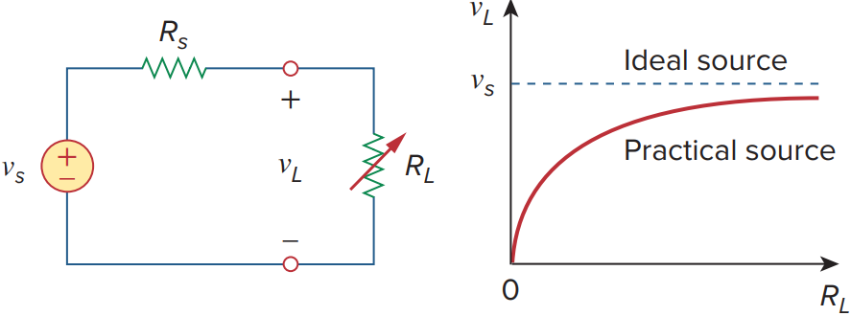
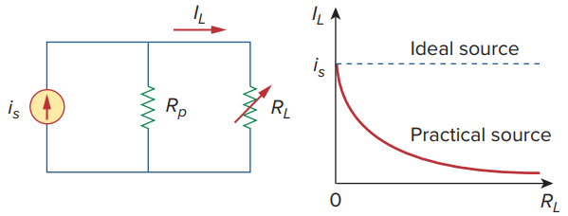
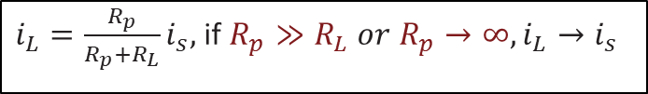
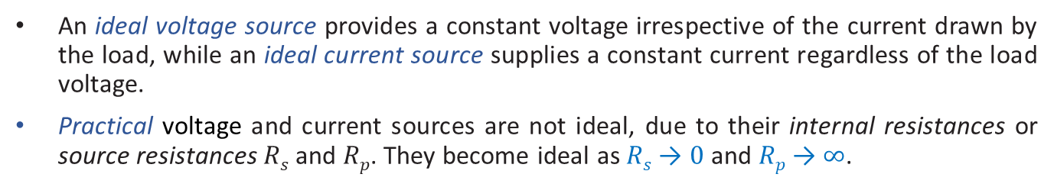
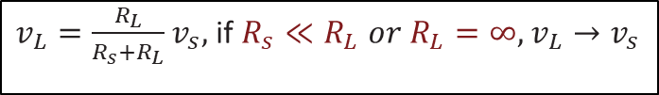
Ideal and non-ideal sources
An ideal voltage source provides a constant voltage irrespective of the current drawn by the load, while an ideal current source supplies a constant current regardless of the load voltage.
Practical voltage and current sources are not ideal, due to their internal resistances or source resistances $Rs$ and $Rp$. They become ideal as $Rs$ → $0$ and $Rp$ → $∞$.
$v_{L}=\frac{R_{L}}{R_{s}+R_{L}}v_{s},$if $R_{s}≪R_{L} or{ R}_{L}=∞, v_{L}→v_{s}$
$i_{L}=\frac{R_{p}}{R_{p}+R_{L}}i_{s},$if $R_{p}≫R_{L} or{ R}_{p}→∞, i_{L}→i_{s}$
[PDS] Purbayan Das
CSE250 – Circuits and Electronics
Department of CSE, BracU
[PDS] Purbayan Das
2
10/25/2023
2

Slide 3
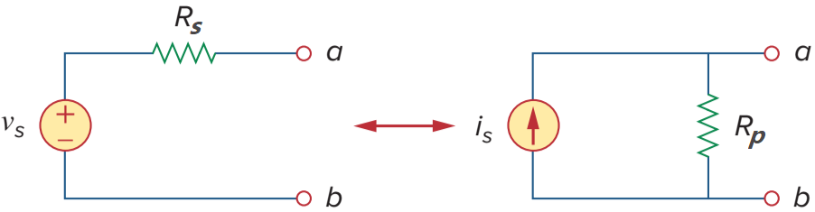
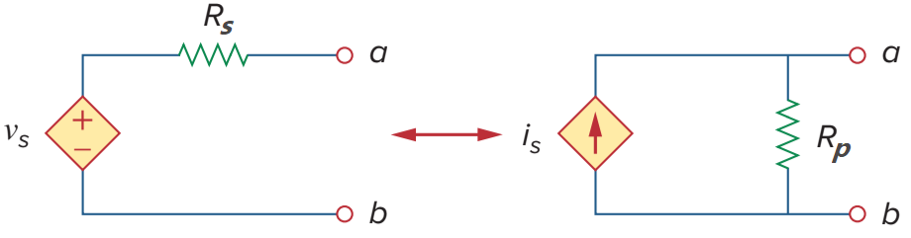
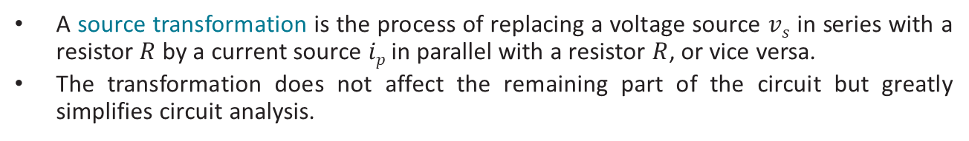
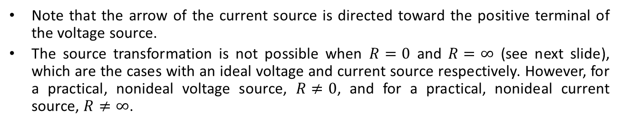
Source Transformation
A source transformation is the process of replacing a voltage source $vs$ in series with a resistor $R$ by a current source $ip$ in parallel with a resistor $R$, or vice versa.
The transformation does not affect the remaining part of the circuit but greatly simplifies circuit analysis.
Note that the arrow of the current source is directed toward the positive terminal of the voltage source.
The source transformation is not possible when $R=0$ and $R=∞$ (see next slide), which are the cases with an ideal voltage and current source respectively. However, for a practical, nonideal voltage source, $R≠0$, and for a practical, nonideal current source, $R≠∞$.
[PDS] Purbayan Das
CSE250 – Circuits and Electronics
Department of CSE, BracU
3

Slide 4
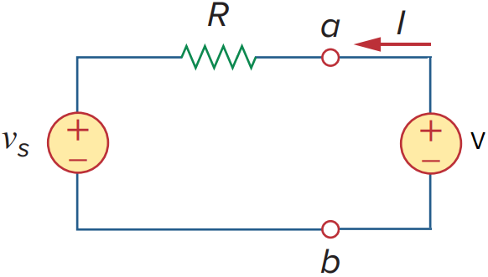
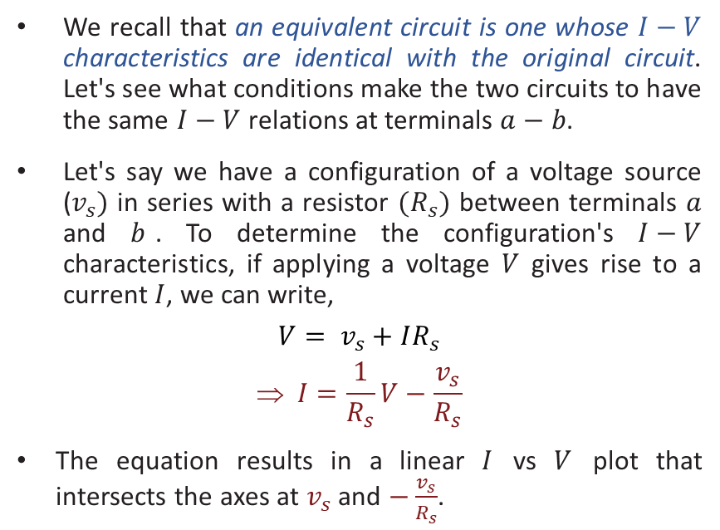
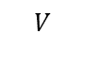
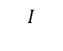
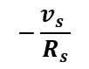
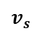
V in series with a R
s
We recall that an equivalent circuit is one whose $I−V$ characteristics are identical with the original circuit. Let's see what conditions make the two circuits to have the same $I−V$ relations at terminals $a−b$.
Let's say we have a configuration of a voltage source ($v_{s})$ in series with a resistor $(R_{s})$ between terminals $a$ and $b$. To determine the configuration's $I−V$ characteristics, if applying a voltage $V$ gives rise to a current $I$, we can write,
$$V= v_{s}+IR_{s}$$
$$ I=\frac{1}{R_{s}}V−\frac{v_{s}}{R_{s}}$$
The equation results in a linear $I$ vs $V$ plot that intersects the axes at $v_{s}$ and $−\frac{v_{s}}{R_{s}}$.
$$I$$
$$v_{s}$$
$$V$$
$$−\frac{v_{s} }{R_{s}}$$
[PDS] Purbayan Das
CSE250 – Circuits and Electronics
Department of CSE, BracU
4

Slide 5
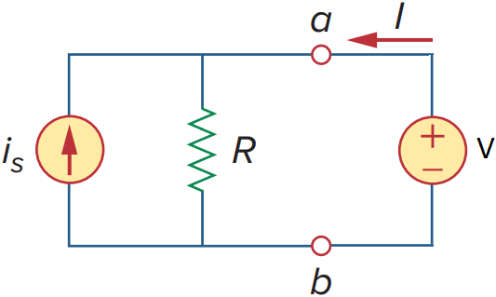
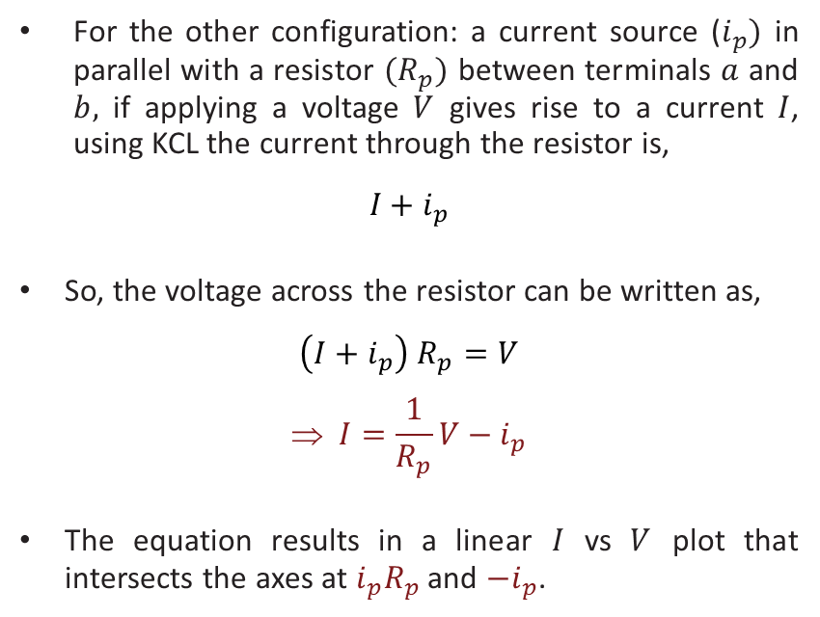
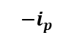
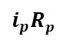
I in parallel with a R
For the other configuration: a current source ($i_{p})$ in parallel with a resistor ${(R}_{p})$ between terminals $a$ and $b,$ if applying a voltage $V$ gives rise to a current $I$, using KCL the current through the resistor is,
$$I+i_{p}$$
So, the voltage across the resistor can be written as,
$$\left(I+i_{p}\right) R_{p}=V$$
$$ I=\frac{1}{R_{p}}V−i_{p}$$
The equation results in a linear $I$ vs $V$ plot that intersects the axes at $i_{p}R_{p}$ and ${−i}_{p}$.
p
p
$$I$$
$$i_{p}Rp$$
$$V$$
$$−i_{p}$$
[PDS] Purbayan Das
CSE250 – Circuits and Electronics
Department of CSE, BracU
5

Slide 6
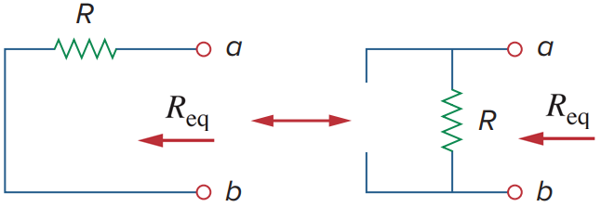
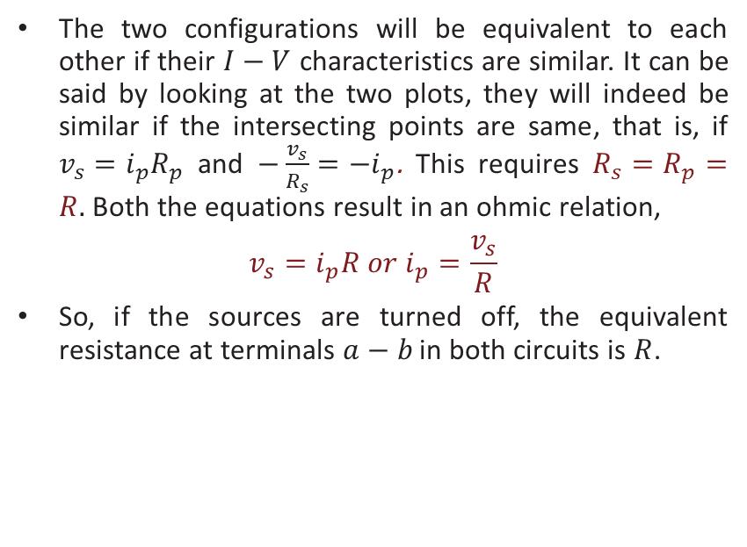


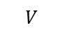
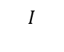
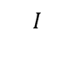
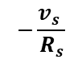
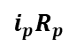
Conditions for transformation
$$I$$
$V$ in series with a $R$
The two configurations will be equivalent to each other if their $I−V$ characteristics are similar. It can be said by looking at the two plots, they will indeed be similar if the intersecting points are same, that is, if $v_{s}=i_{p}R_{p}$ and $−\frac{v_{s}}{R_{s}}=−i_{p}$. This requires $R_{s}=R_{p}=R.$ Both the equations result in an ohmic relation,
$$v_{s}=i_{p}R or{ i}_{p}=\frac{v_{s}}{R}$$
So, if the sources are turned off, the equivalent resistance at terminals $a−b$ in both circuits is $R$.
$$v_{s}$$
$$V$$
$$−\frac{v_{s} }{R_{s}}$$
$$I$$
$$I$$
$I$ in parallel with a $R$
$$i_{p}R_{p}$$
$$V$$
$$−i_{p}$$
[PDS] Purbayan Das
CSE250 – Circuits and Electronics
Department of CSE, BracU
6

Slide 7
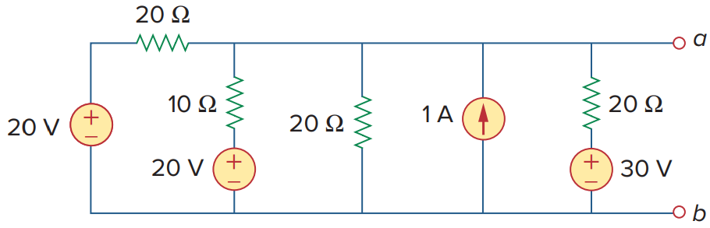
Example 1
Use source transformation to reduce the circuit between terminals a and b shown to a single voltage source in series with a single resistor.
[PDS] Purbayan Das
CSE250 – Circuits and Electronics
Department of CSE, BracU
7

Slide 8
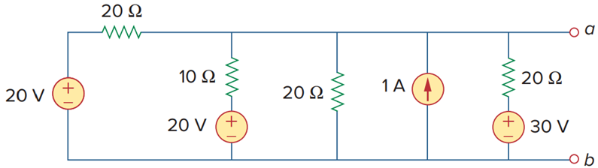
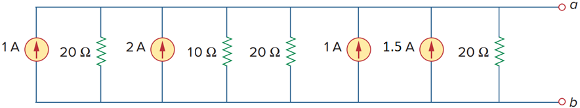
Example 1: transforming sources
[PDS] Purbayan Das
CSE250 – Circuits and Electronics
Department of CSE, BracU
8

Slide 9
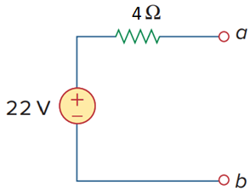
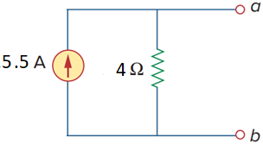
Example 1 (contd … 2)
[PDS] Purbayan Das
CSE250 – Circuits and Electronics
Department of CSE, BracU
9

Slide 10
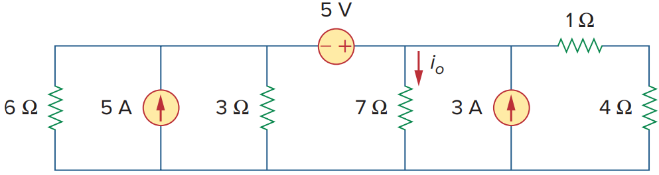
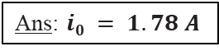
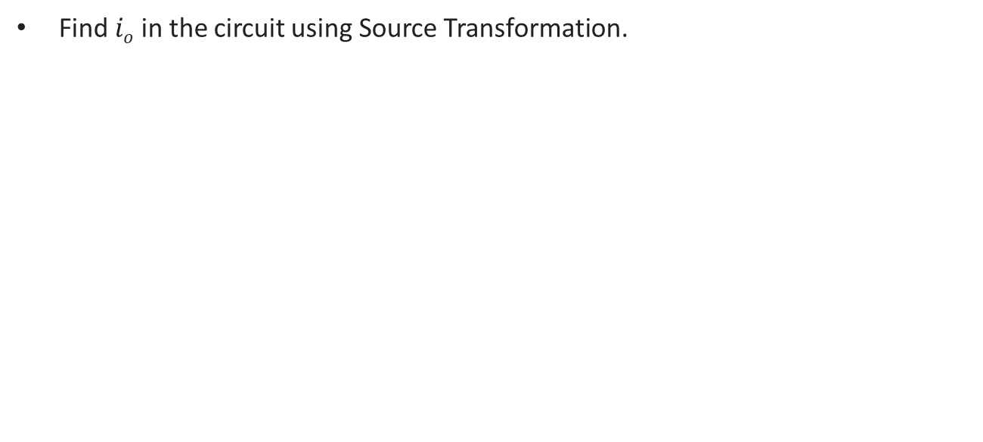
Problem 2
Find $io$ in the circuit using Source Transformation.
Ans: $i0 = 1.78 A$
[PDS] Purbayan Das
CSE250 – Circuits and Electronics
Department of CSE, BracU
10

Slide 11
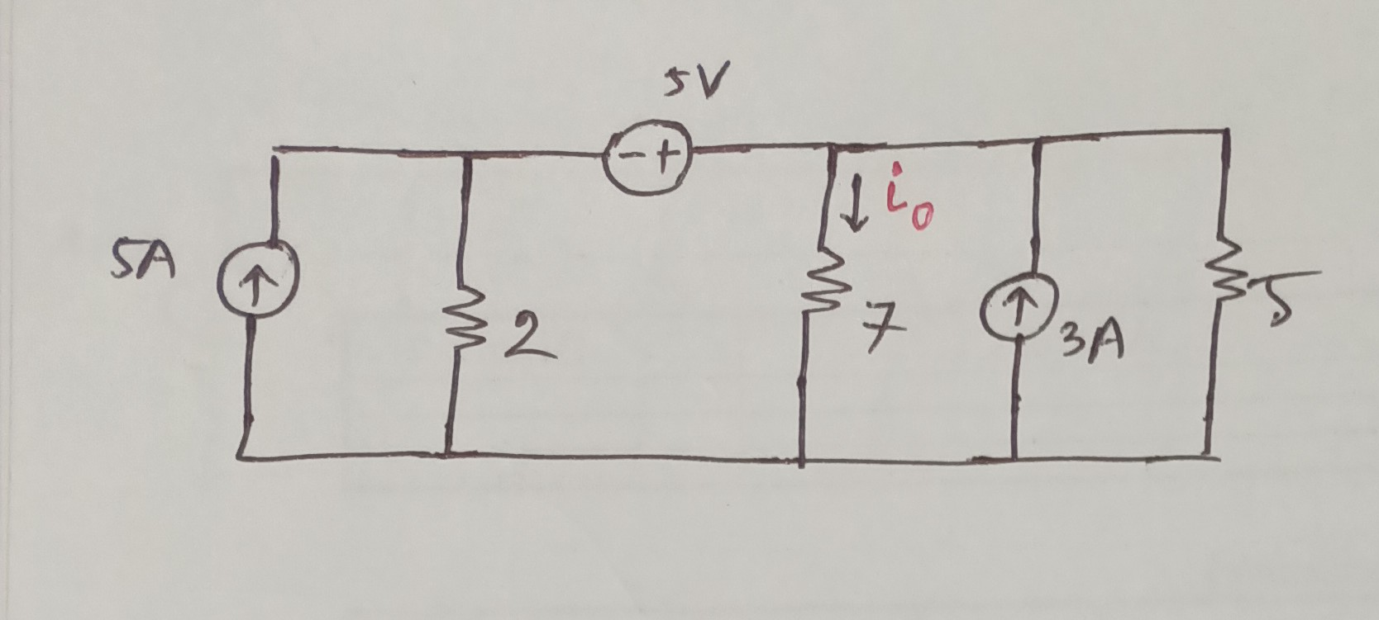
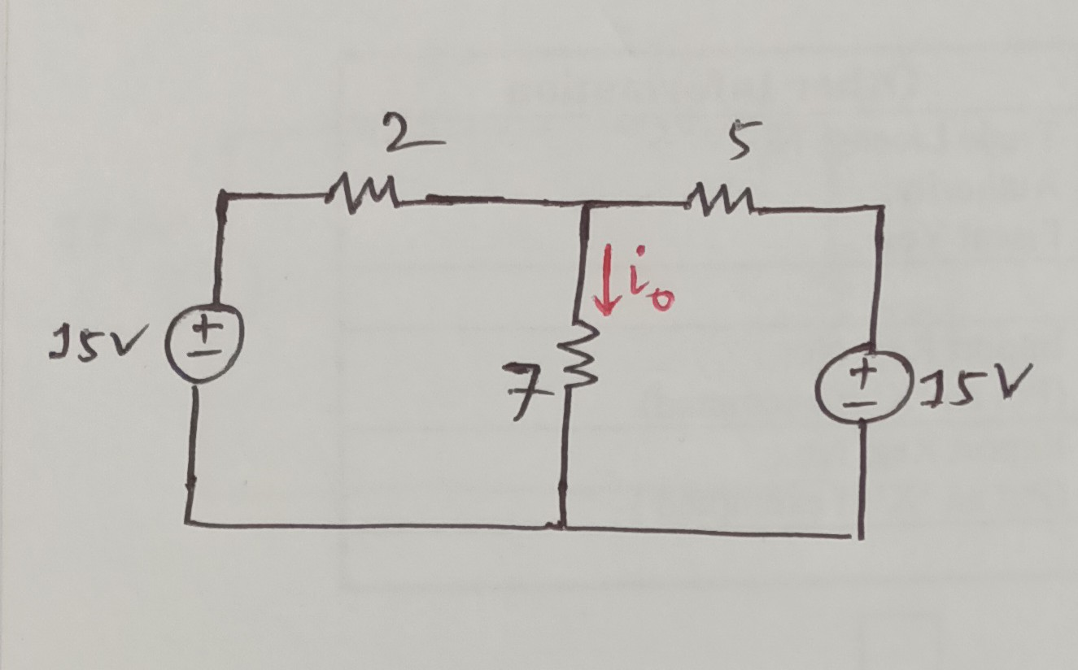
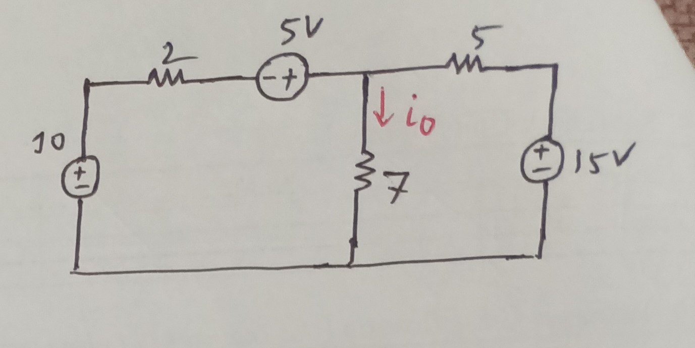
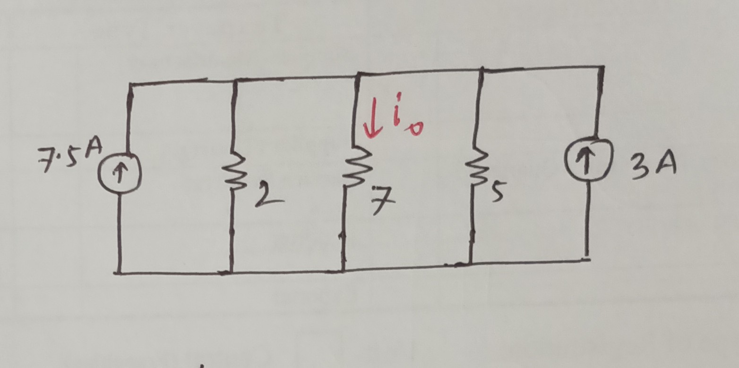
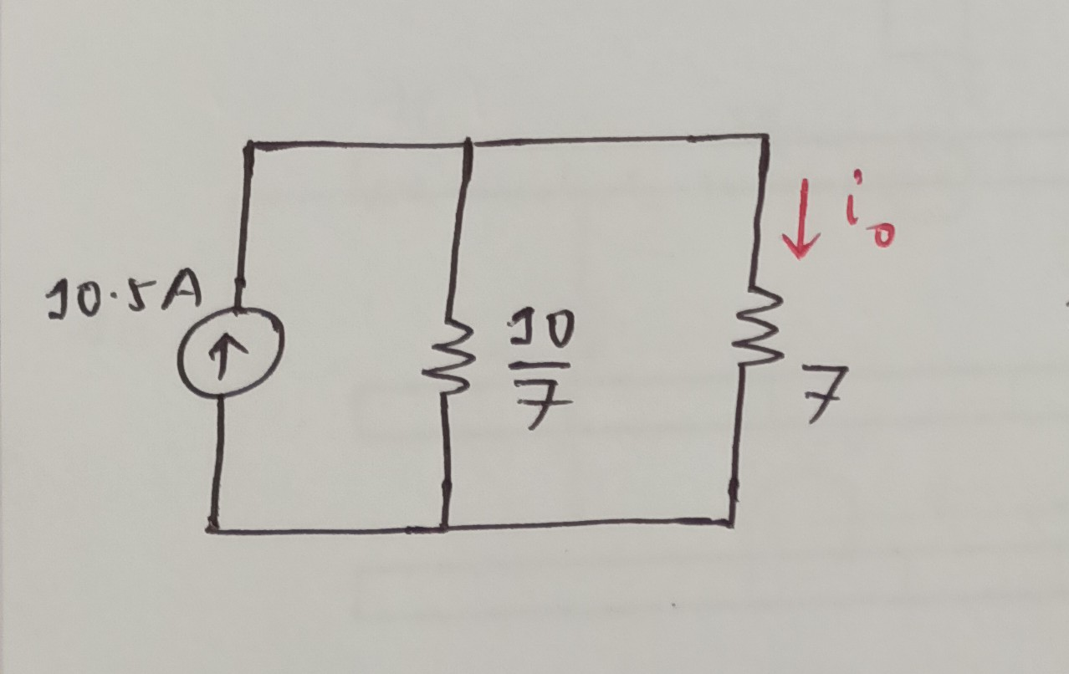
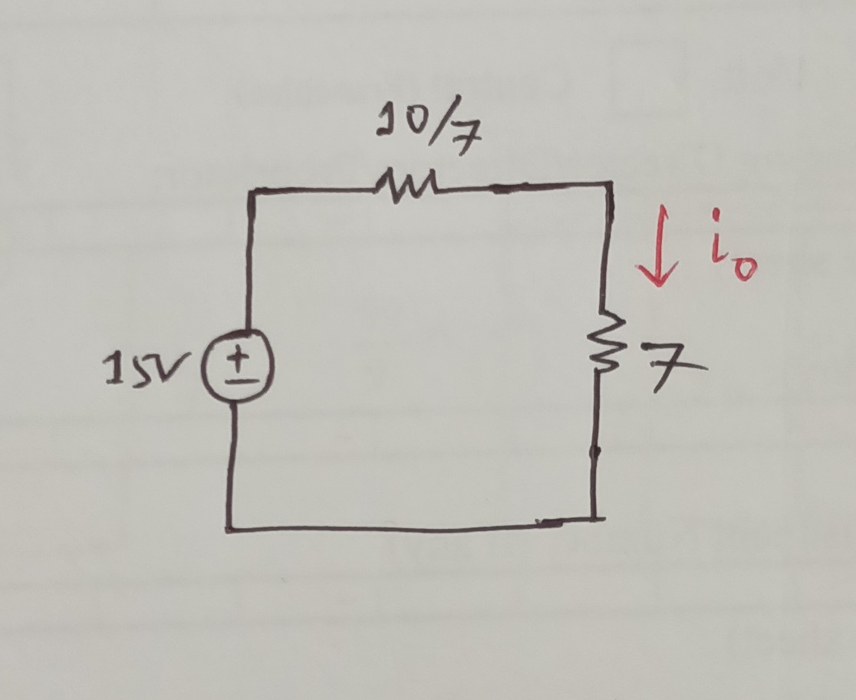

$$i_{o}=\frac{15}{\frac{10}{7}+7}$$
[PDS] Purbayan Das
CSE250 – Circuits and Electronics
Department of CSE, BracU
11

Slide 12
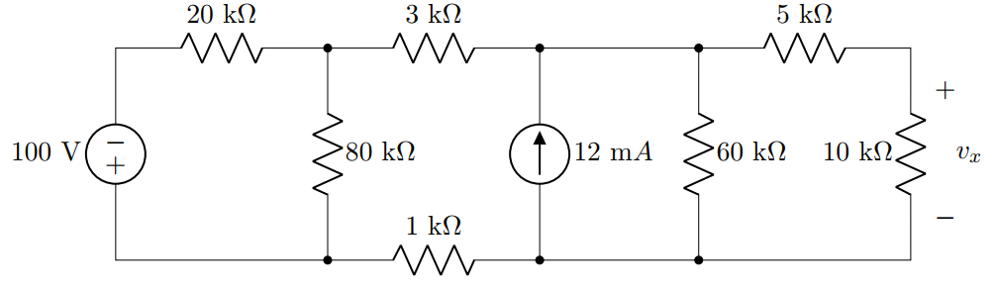
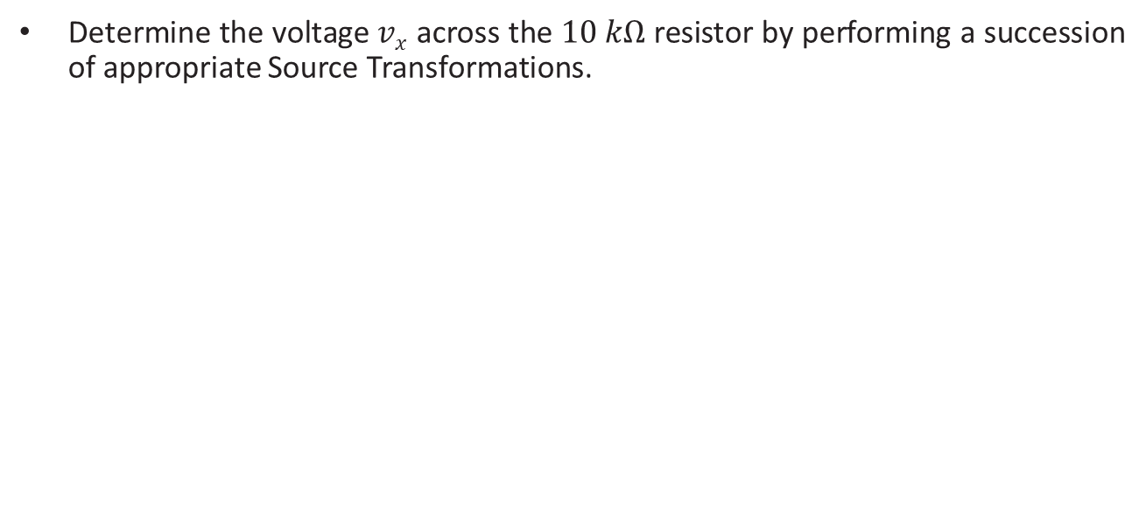
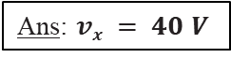
Problem 3
Determine the voltage $vx$ across the $10 kΩ$ resistor by performing a succession of appropriate Source Transformations.
Ans: $vx = 40 V$
Fall'22
[PDS] Purbayan Das
CSE250 – Circuits and Electronics
Department of CSE, BracU
12

Slide 13
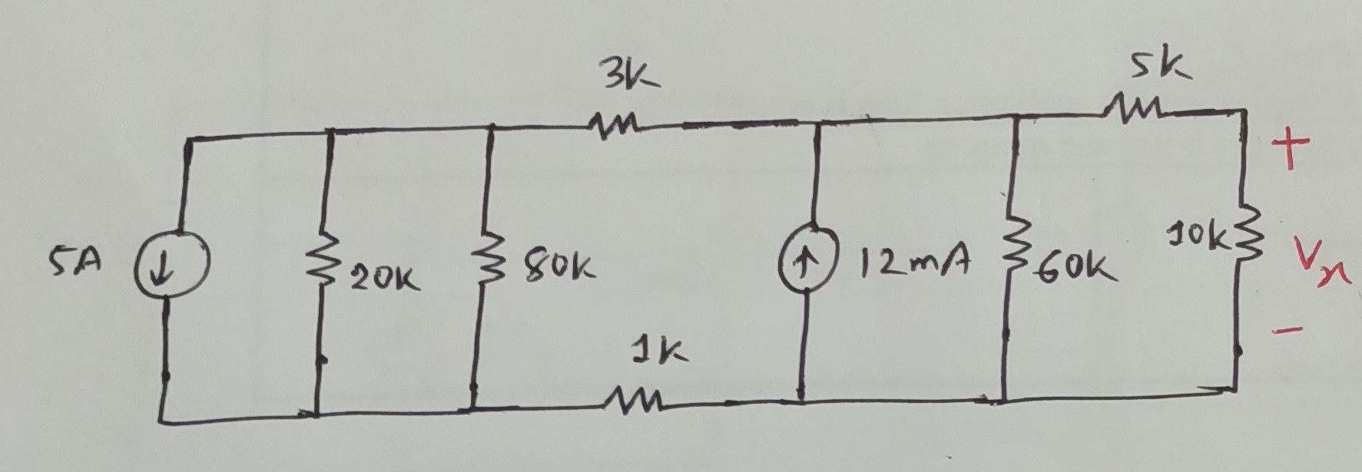
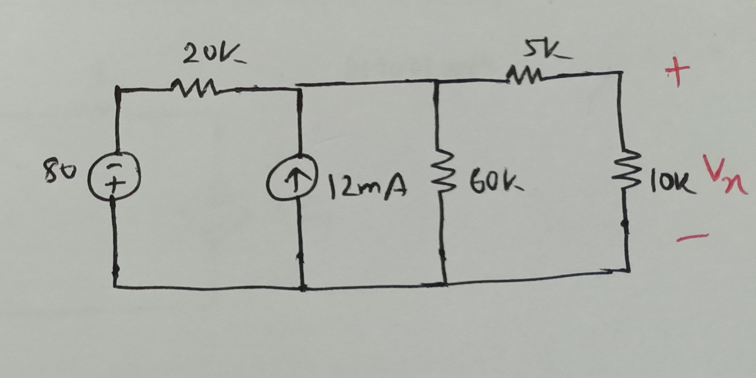
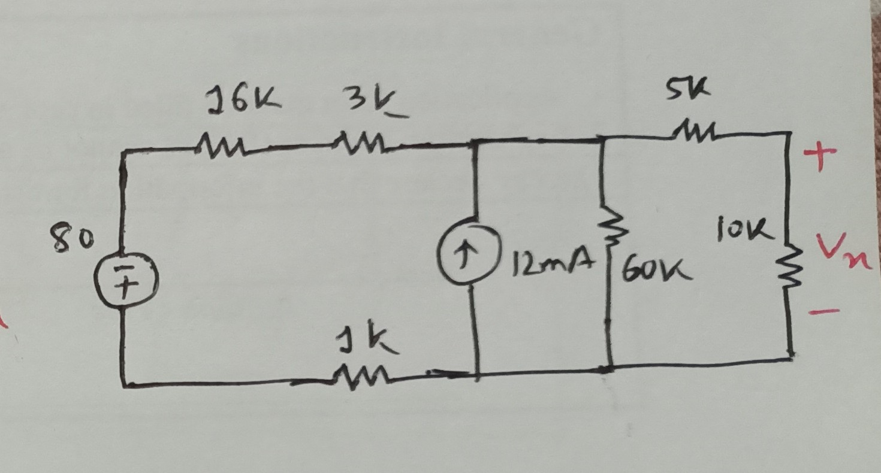
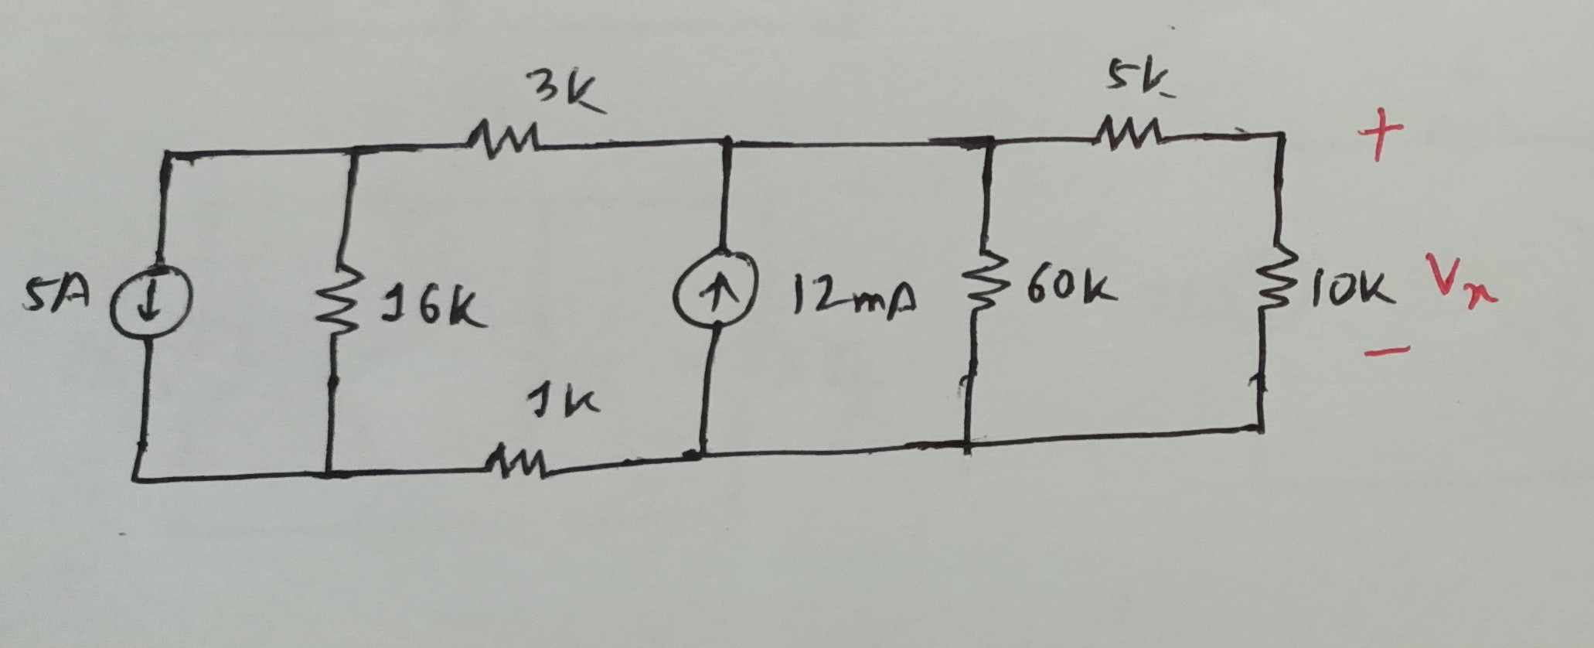
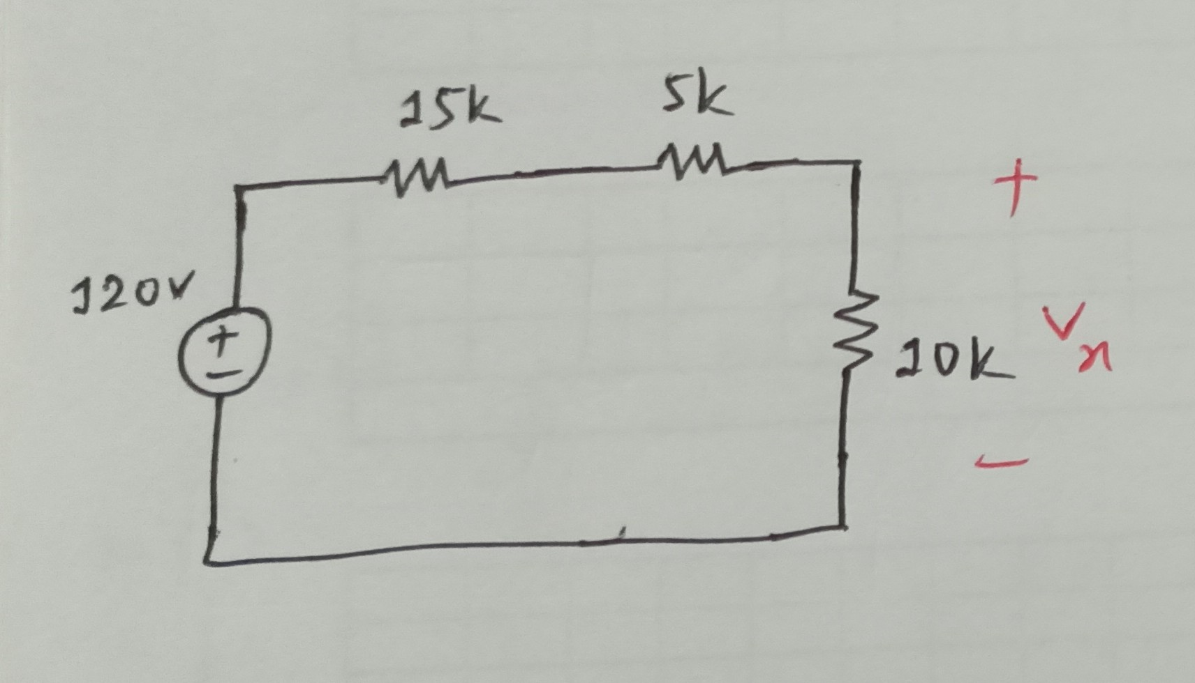
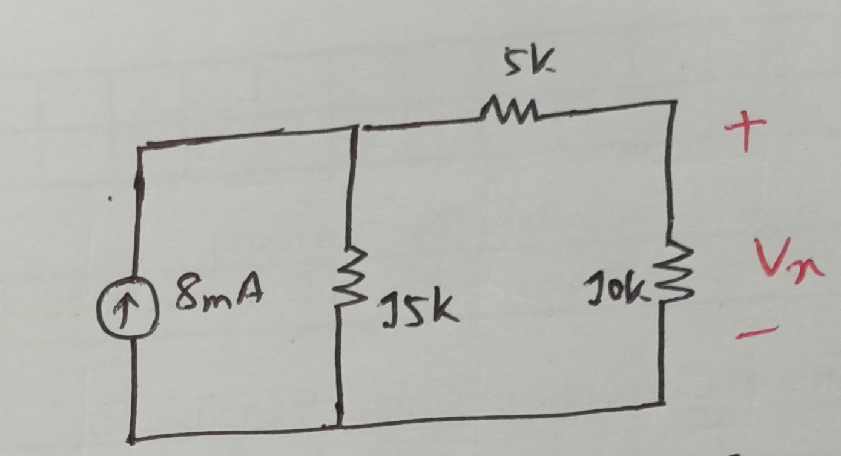
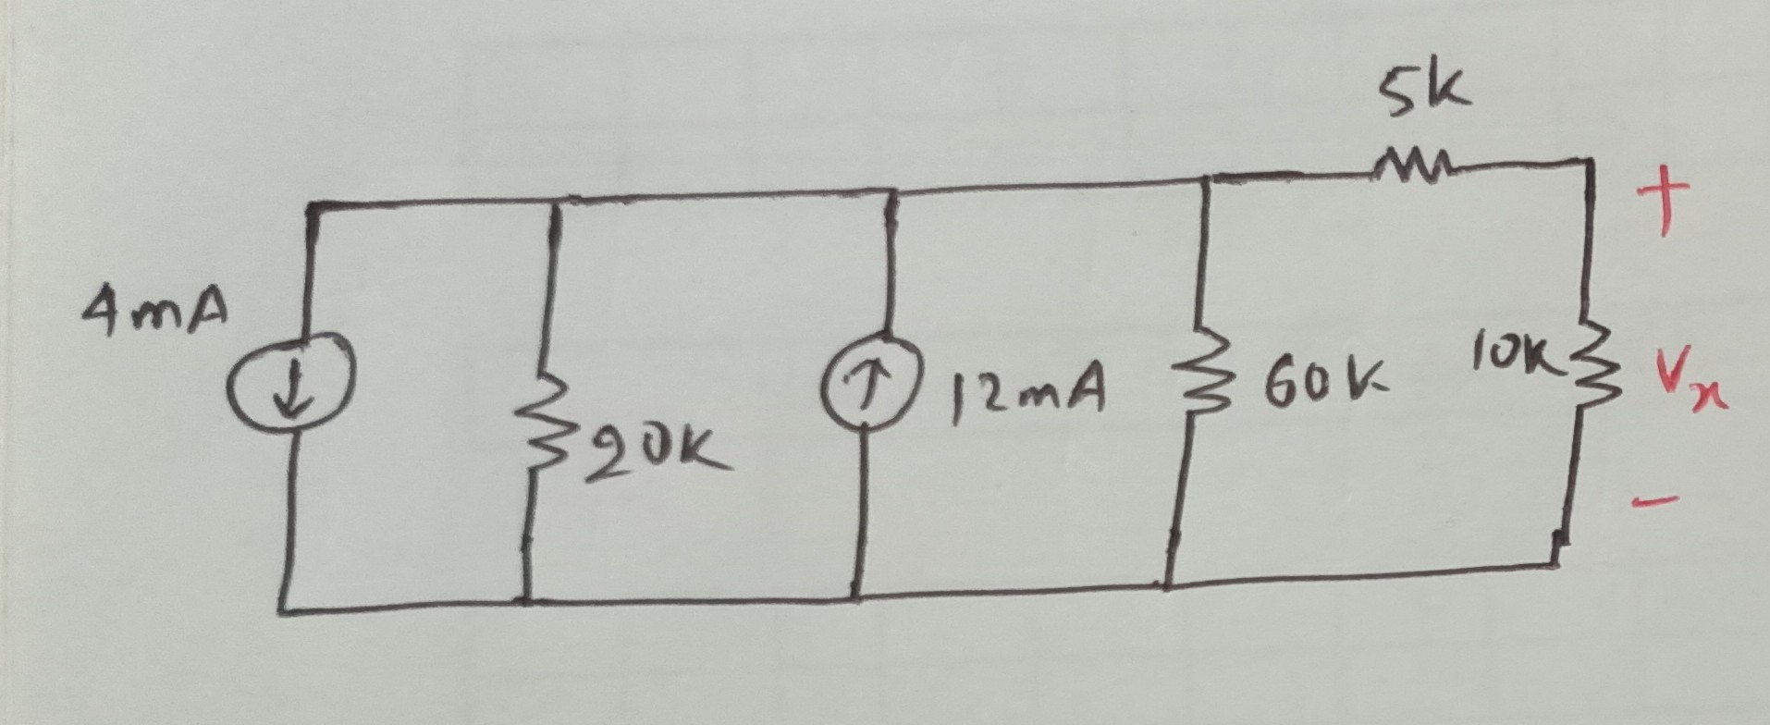
[PDS] Purbayan Das
CSE250 – Circuits and Electronics
Department of CSE, BracU
13

Slide 14

$$v_{x}=\frac{10}{10+5+15}×120=40 V$$

Slide 15



Problem 7
Reduce the circuit to a single loop. If $i=2.5 A$, determine $v_{0}$.
Ans: v$0 =28 V$
[PDS] Purbayan Das
CSE250 – Circuits and Electronics
Department of CSE, BracU
15

Slide 16





[PDS] Purbayan Das
CSE250 – Circuits and Electronics
Department of CSE, BracU
16

Slide 17
$$6=9i+12i−36+7i−V_{o}$$
$$or, 42=28i−V_{o}$$
$$or, 42=28×2.5−V_{o}$$
$$or, V_{o}=28 V$$

Slide 18



Problem 8
Reduce the circuit to a single loop using Source Transformation. Then determine $I_{y}$.
Ans: $Iy =1 A$
[PDS] Purbayan Das
CSE250 – Circuits and Electronics
Department of CSE, BracU
18

Slide 19




[PDS] Purbayan Das
CSE250 – Circuits and Electronics
Department of CSE, BracU
19

Slide 20



$$12=6I_{y}+3I_{y}+3I_{y}$$
$$12=12I_{y}$$
$$I_{y}=1$$

Slide 21



Problem 9
Reduce the circuit to a single loop using Source Transformation. Then determine $V_{x}$.
Ans: $Vx =9.5 V$
[PDS] Purbayan Das
CSE250 – Circuits and Electronics
Department of CSE, BracU
21

Slide 22







[PDS] Purbayan Das
CSE250 – Circuits and Electronics
Department of CSE, BracU
22

Slide 23



$$V_{x}=3i+{9V}_{x}$$
$$or, i=−\frac{8V_{x}}{3}$$
$$20−\frac{26V_{x}}{3}=2i+V_{x}$$
$$20−\frac{26V_{x}}{3}=2(−\frac{8V_{x}}{3})+V_{x}$$

Slide 24


Problem 1
Use Source Transformation to find the voltage $v0$. Find the power developed by the $250 V$ source and $8 A$ source.
A resistor in series with a current source is redundant, as is a resistor in parallel with a voltage source. We can remove them; this will have no effect on the circuit except for the sources. Opening a resistor parallel to a voltage source will reduce the current supplied by the source. Similarly, shorting a resistor in series with a current source increases the voltage across the current source. We have to keep in mind those facts while calculating parameters for the sources.
[PDS] Purbayan Das
CSE250 – Circuits and Electronics
Department of CSE, BracU
24

Slide 25




$$V_{0}=\frac{100}{100+\frac{100}{9}}×\frac{200}{9}$$
= 20 V
[PDS] Purbayan Das
CSE250 – Circuits and Electronics
Department of CSE, BracU
25

Slide 26
Problem 1
Use Source Transformation to find the voltage $v0$. Find the power developed by the $250 V$ source and $8 A$ source.
$$P_{8A}=8\left(20−80\right)=−480 W \left(Supplying\right)$$
$$P_{250V}=−250×11.2=−2.8 kW \left(Supplying\right)$$
[PDS] Purbayan Das
CSE250 – Circuits and Electronics
Department of CSE, BracU
26

Slide 27
Thank you for your attention
[PDS] Purbayan Das
CSE250 – Circuits and Electronics
Department of CSE, BracU
27

